Slide 1
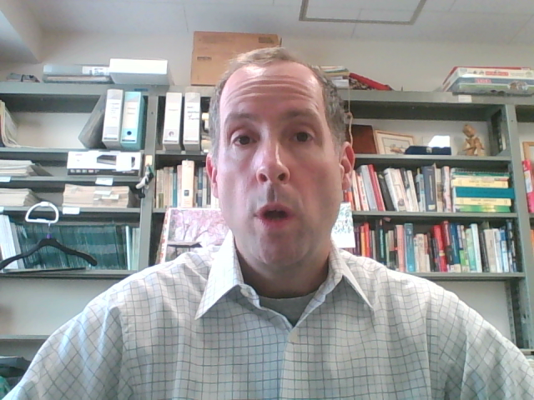
Academic Study Skills
Parsons Spring 2020

Slide 2
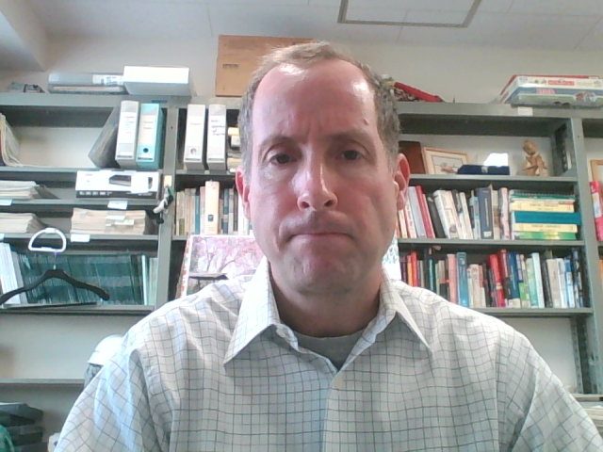
Topics/Readings
1. The Power of the Market/The Tyranny of Controls (M. Friedman)
2. From Cradle to Grave (M. Friedman)
3. The Role of Government
4. Killer Airbags (Miller et al)
5. Is Water Different? (Miller et al)
6. Buy Local? (MRU video and other material)
7. Fair Trade
8. Health Insurance for All...Or Maybe Not? (Miller et al)
9. Saving Species (Miller et al)
10. The Effects of Minimum Wage (Miller et al)
(subject to change)

Slide 3
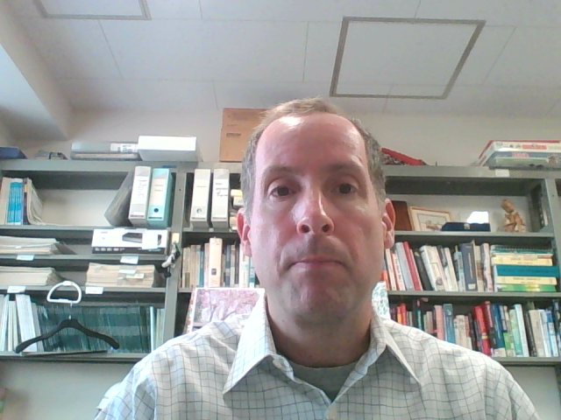
Grading
40% Attendance
60% Writing
Attendance will be regular `attendance` at our periodic Zoom meetings.
There will be 5 writing assignments (about 2000 words) for which you will be graded.
There will be chances to submit your assignments, get feedback, improve and submit again for higher grade.

